Slide 2
understand CSS Layout - float and clear property.

Slide 3

CSS Layout - float and clear
The CSS float property specifies how an element should float.
The CSS clear property specifies what elements can float beside the cleared element and on which side.

Slide 4
The float Property
The float property is used for positioning and formatting content e.g. let an image float left to the text in a container.
The float property can have one of the following values:
left - The element floats to the left of its container
right - The element floats to the right of its container
none - The element does not float (will be displayed just where it occurs in the text). This is default
inherit - The element inherits the float value of its parent

Slide 5
The float Property
In its simplest use, the float property can be used to wrap text around images.

Slide 6
Example - float: right;

Slide 7
Example
img
{
float: right;
}

Slide 8
Example - float: left;
Example
img {
float: left;
}

Slide 9
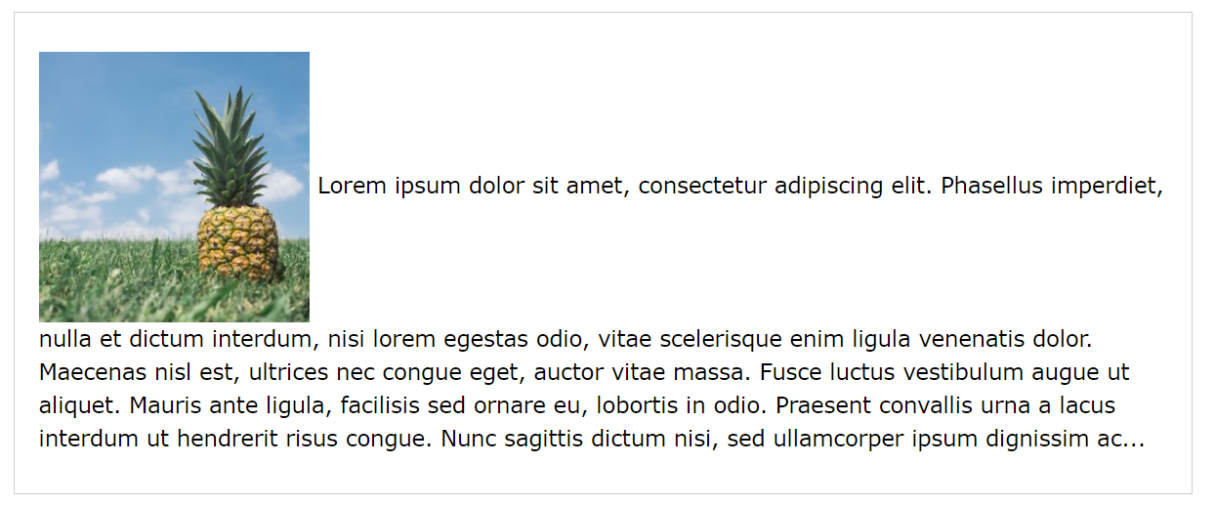
Example - No float
In the following example the image will be displayed just where it occurs in the text (float: none;):

Slide 10
Example - Float Next To Each Other
Normally div elements will be displayed on top of each other. However, if we use float: left we can let elements float next to each other.

Slide 11
The clear Property
When we use the float property, and we want the next element below (not on right or left), we will have to use the clear property.
The clear property specifies what should happen with the element that is next to a floating element

Slide 12
The clear property can have one of the following values:
none - The element is not pushed below left or right floated elements. This is default
left - The element is pushed below left floated elements
right - The element is pushed below right floated elements
both - The element is pushed below both left and right floated elements
inherit - The element inherits the clear value from its parent

Slide 13
The clear property
When clearing floats, you should match the clear to the float: If an element is floated to the left, then you should clear to the left. Your floated element will continue to float, but the cleared element will appear below it on the web page.

Slide 14
Example
This example clears the float to the left. Here, it means that the <div2> element is pushed below the left floated <div1> element:
div1
{
float: left;
}
div2
{
clear: left;
}

Slide 15
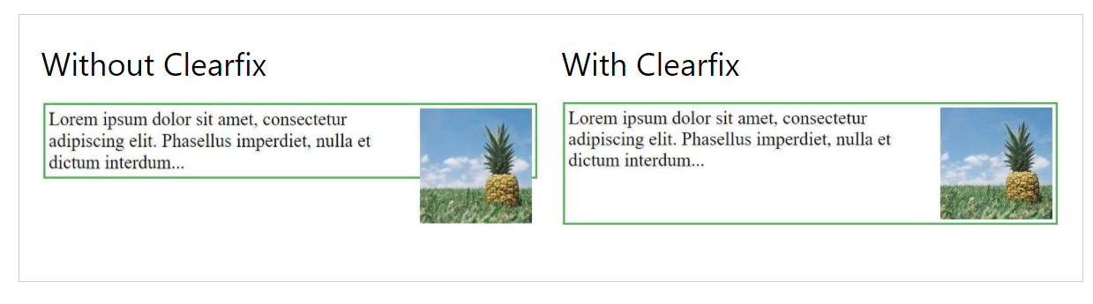
The clearfix Hack
If a floated element is taller than the containing element, it will "overflow" outside of its container. We can then add a clearfix hack to solve this problem:

Slide 16
Practical

